Slide 1
Week1 Summary

Slide 2

What is deep learning?
Wikipedia says:
“Deep learning is a branch of machine learning based on a set of algorithms that attempt to model high-level abstractions in data by using multiple processing layers, with complex structures or otherwise, composed of multiple non-linear transformations.”
High-level
abstraction
Machine
Learning
Network

Slide 3
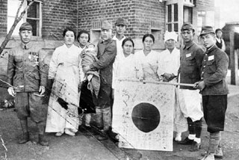
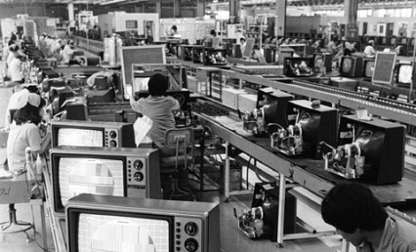
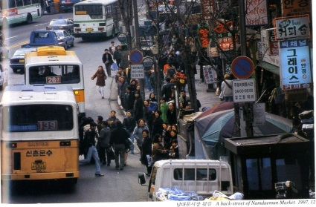

Is it brand new?
Neural Nets
McCulloch & Pitt 1943
Perception
Rosenblatt 1958
RNN
Grossberg 1973
CNN
Fukushima 1979
RBM
Hinton 1999
DBN
Hinton 2006
D-AE
Vincent 2008
AlexNet
Alex 2012
GoogLeNet
Szegedy 2015

Slide 4
Deep architectures
Feed-Forward: multilayer neural nets, convolutional nets
Feed-Back: Stacked Sparse Coding, Deconvolutional Nets
Bi-Directional: Deep Boltzmann Machines, Stacked Auto-Encoders
Recurrent: Recurrent Nets, Long-Short Term Memory

Slide 5
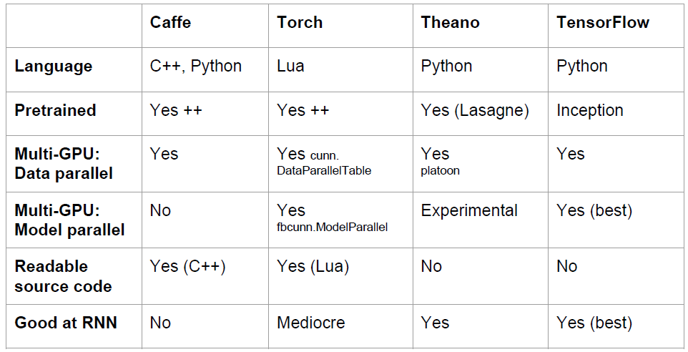
Overview

Slide 6
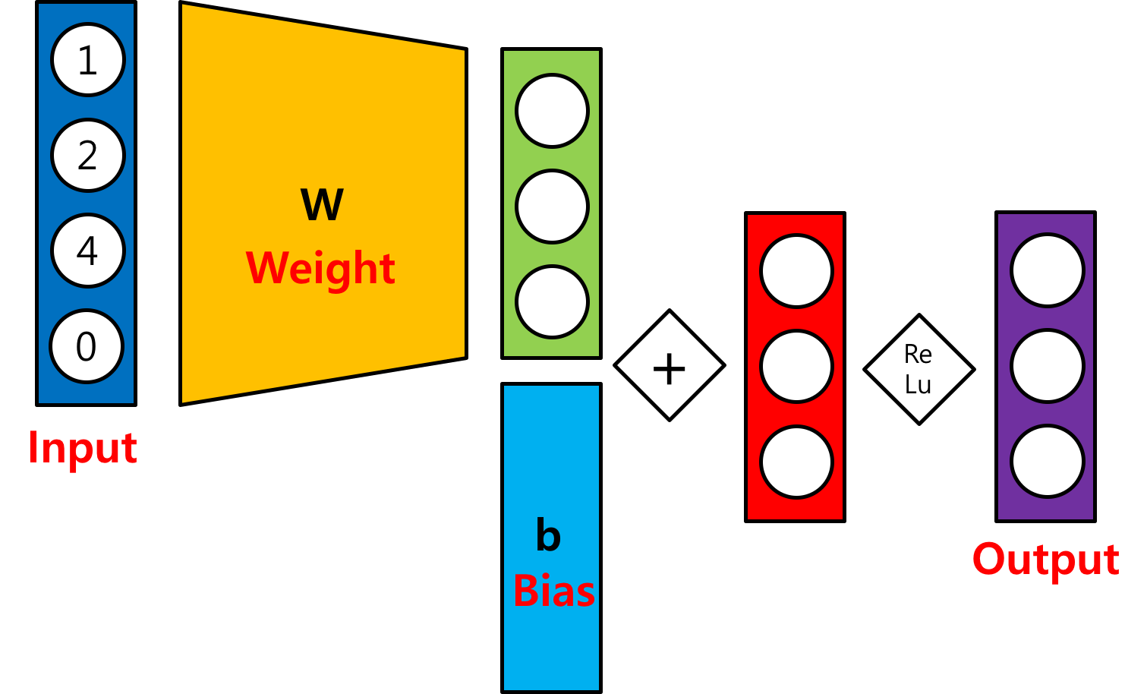
Basic Single Layer Network
Input: $\left[\begin{matrix}\begin{matrix}1 & 2\end{matrix} & \begin{matrix}4 & 0\end{matrix}\end{matrix}\right]$
W: $\left[\begin{matrix}\begin{matrix}\begin{matrix}1 \\ 3\end{matrix} \\ \begin{matrix}−2 \\ 1\end{matrix}\end{matrix} & \begin{matrix}\begin{matrix}0 \\ 0\end{matrix} \\ \begin{matrix}−2 \\ 1\end{matrix}\end{matrix} & \begin{matrix}\begin{matrix}1 \\ 2\end{matrix} \\ \begin{matrix}0 \\ 0\end{matrix}\end{matrix}\end{matrix}\right]$
Bias: $\left[\begin{matrix}2 & 1 & 3\end{matrix}\right]$
$$\left[\begin{matrix}−1 & −8 & 5\end{matrix}\right]$$
$$\left[\begin{matrix}1 & −7 & 8\end{matrix}\right]$$
$$\left[\begin{matrix}1 & 0 & 8\end{matrix}\right]$$

Slide 7
Epoch / Batch size / Iteration
One epoch: one forward and backward pass of all training data
Batch size: the number of training examples in one forward and backward pass
One iteration: number of passes
If we have 55,000 training data, and the batch size is 1,000. Then, we need 55 iterations to complete 1 epoch.

Slide 8
Cost function
This is just a function that we want to minimize.
There is no guarantee that it will bring us to the best solution!
It should be differentiable!

Slide 9
Convolution
http://deeplearning.stanford.edu/wiki/index.php/Feature_extraction_using_convolution

Slide 10
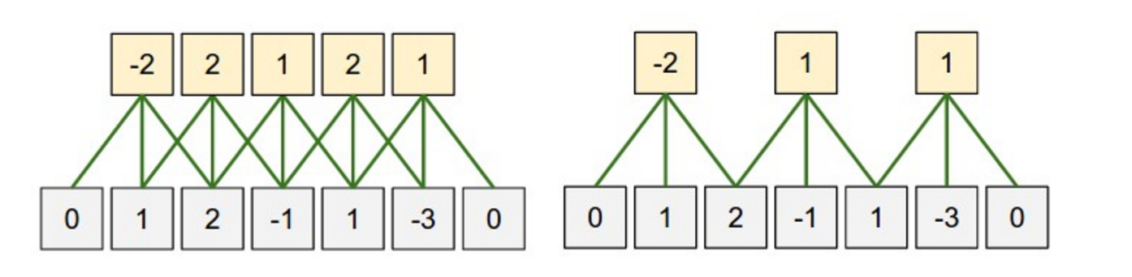
Zero-padding
What is the size of the input?
$n_{in}=5$
What is the size of the output?
$n_{out}=5$
What is the size of the filter?
$n_{filter}=3$
What is the size of the zero-padding?
$n_{padding}=1$
$n_{out}=\left(n_{in}+2∗n_{padding}−n_{filter}\right)+1$
$5=\left(5+2∗1−3\right)+1$

Slide 11
Stride
(Left) Stride size: 1
(Right) Stride size: 2
If stride size equals the filter size, there will be no overlapping.

Slide 12
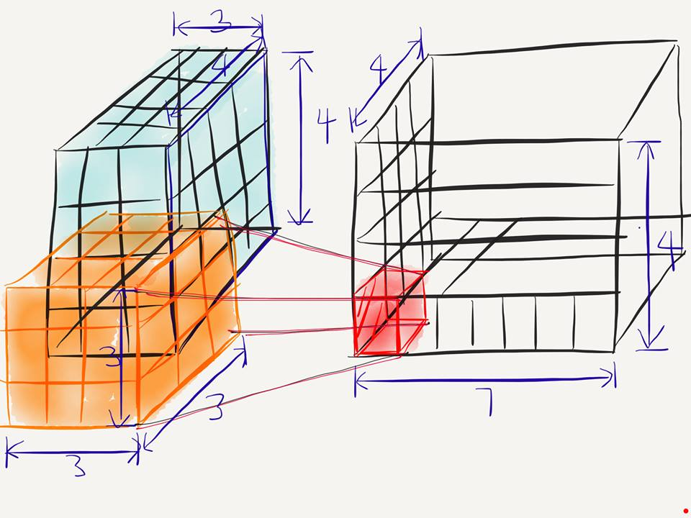
Conv2D
[batch, in_height=4, in_width=4, in_chnnel=3]
[filter_height=3, filter_width=3, in_channels=3, out_channels=7]
What is the number of parameters in this convolution layer?
→ $189= 3∗3∗3∗7$

Slide 13
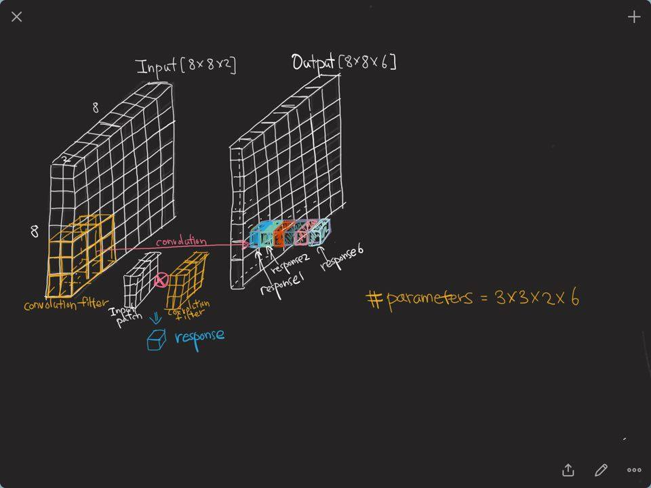
CNN

Slide 14
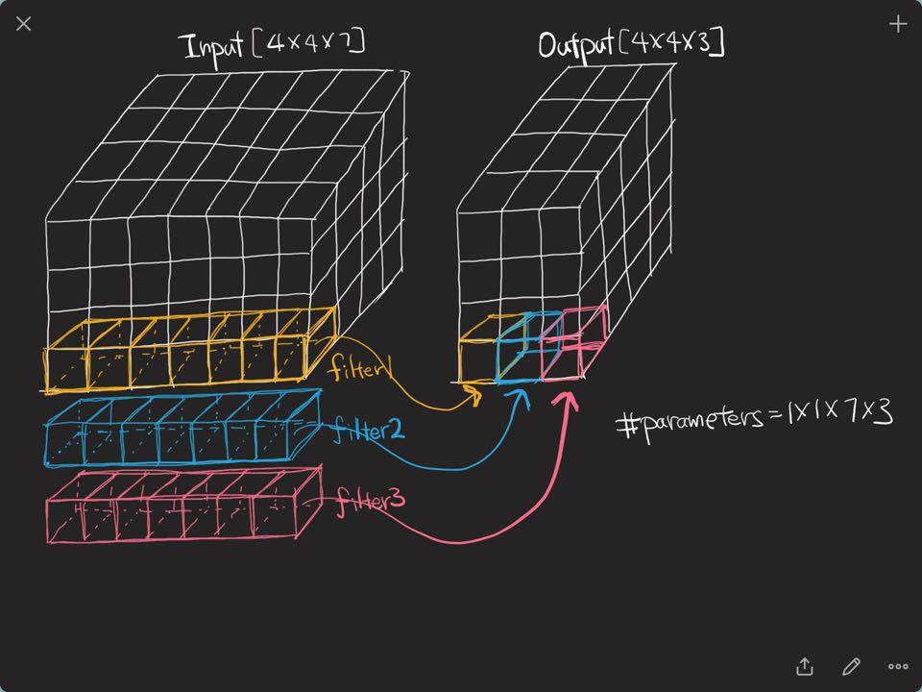
CNN

Slide 15
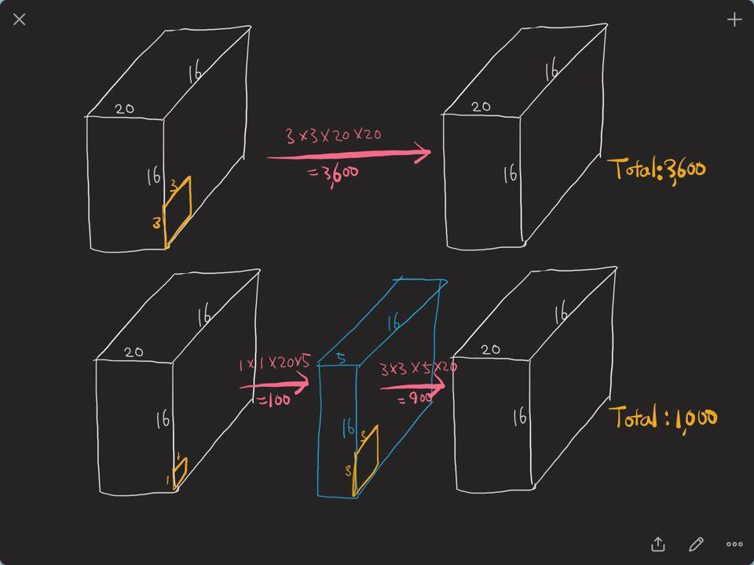
1 by 1 convolution

Slide 16
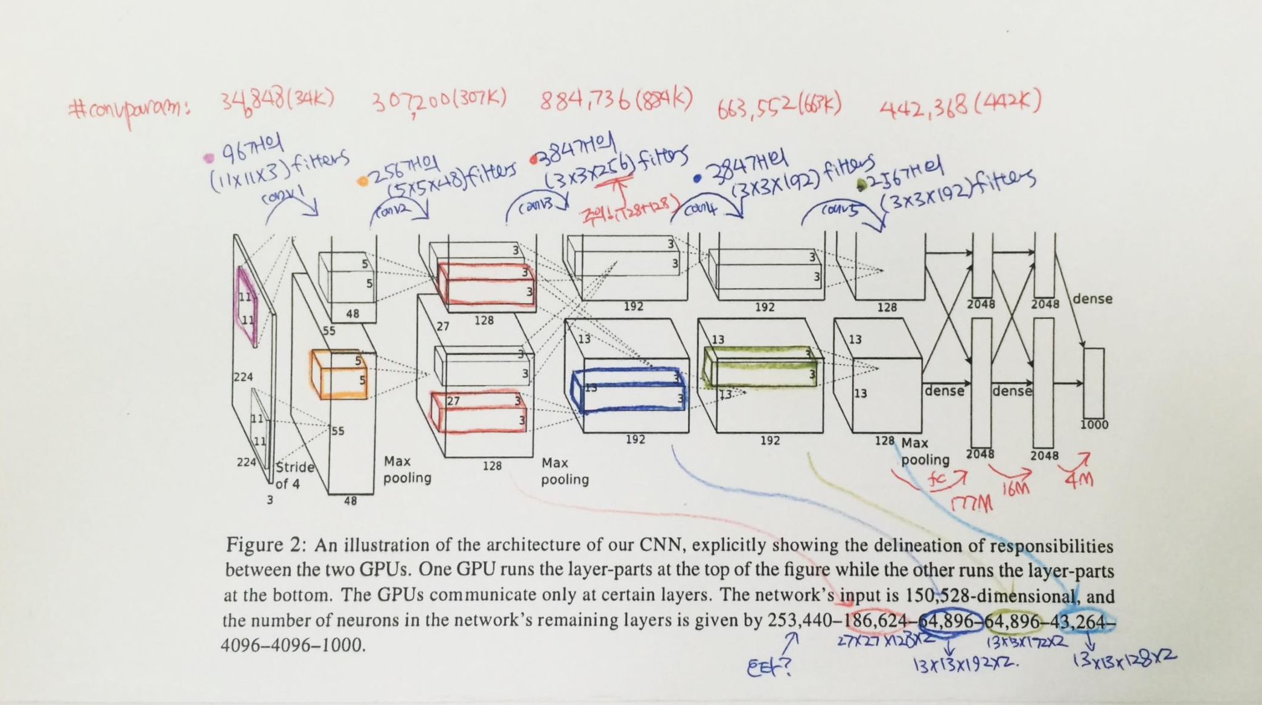
AlexNet : count it yourself!

Slide 17
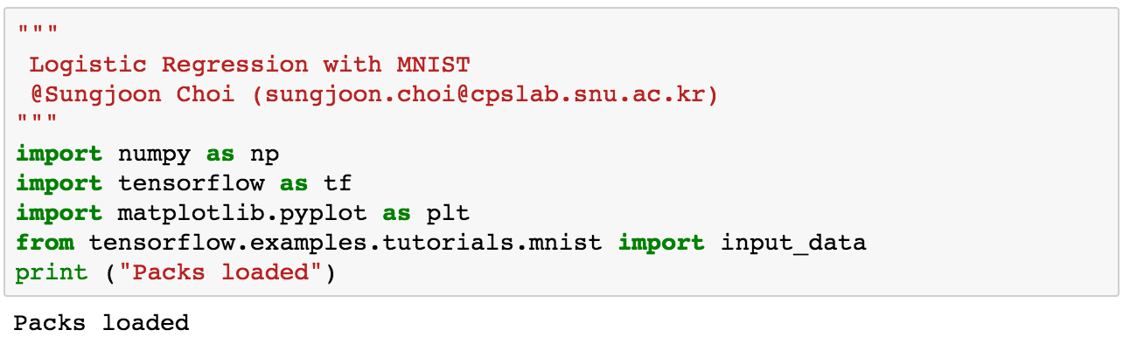
Packages

Slide 18
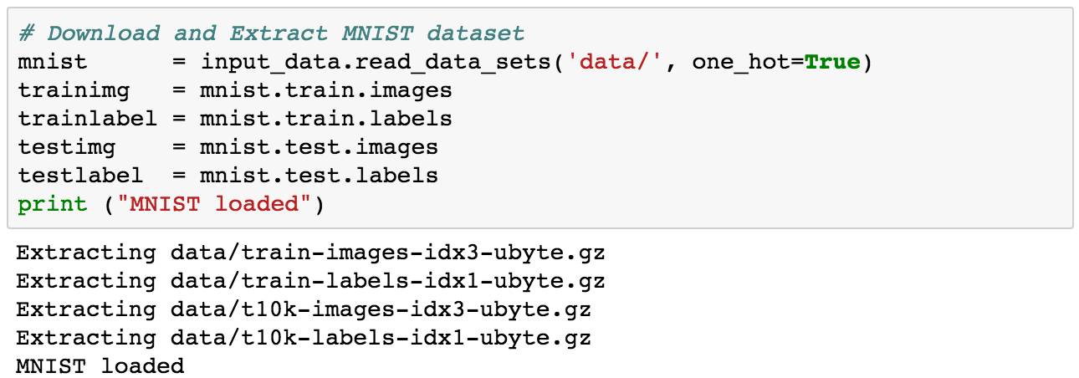
MNIST

Slide 19
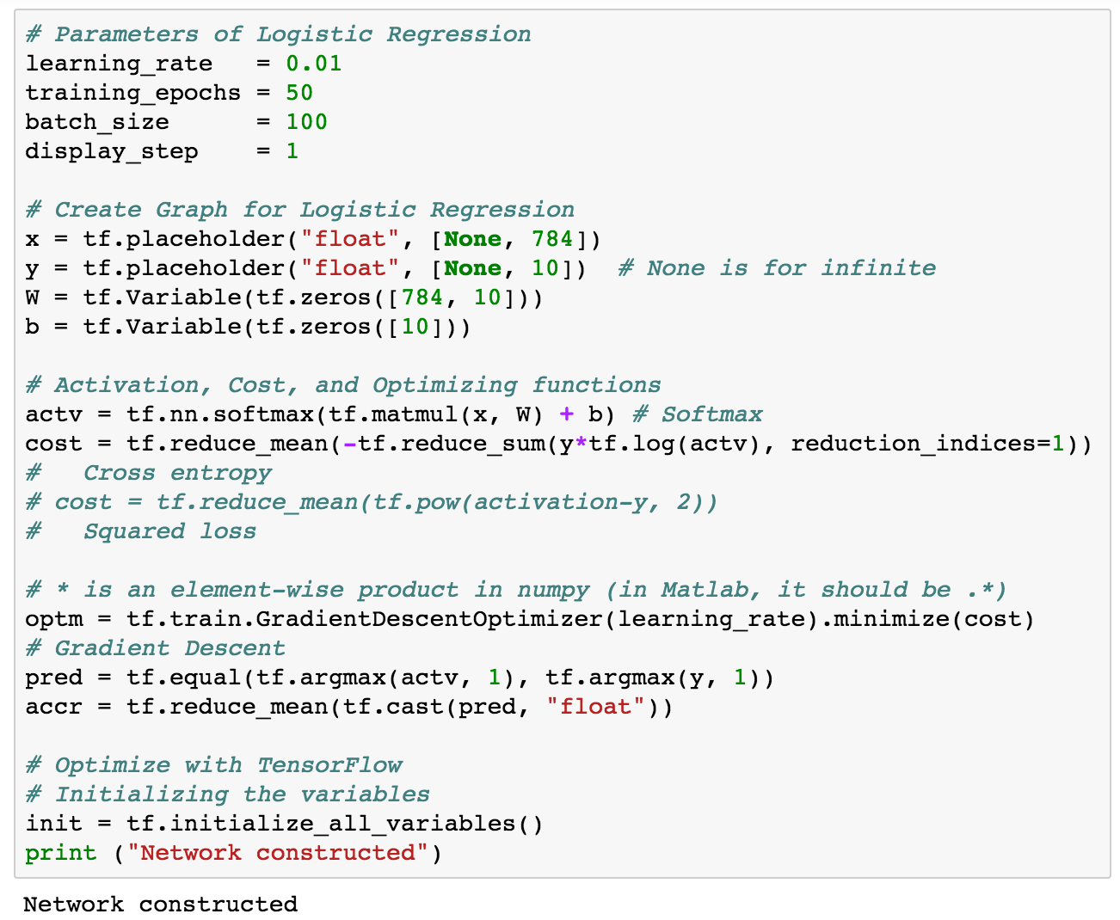
Construct nets

Slide 20
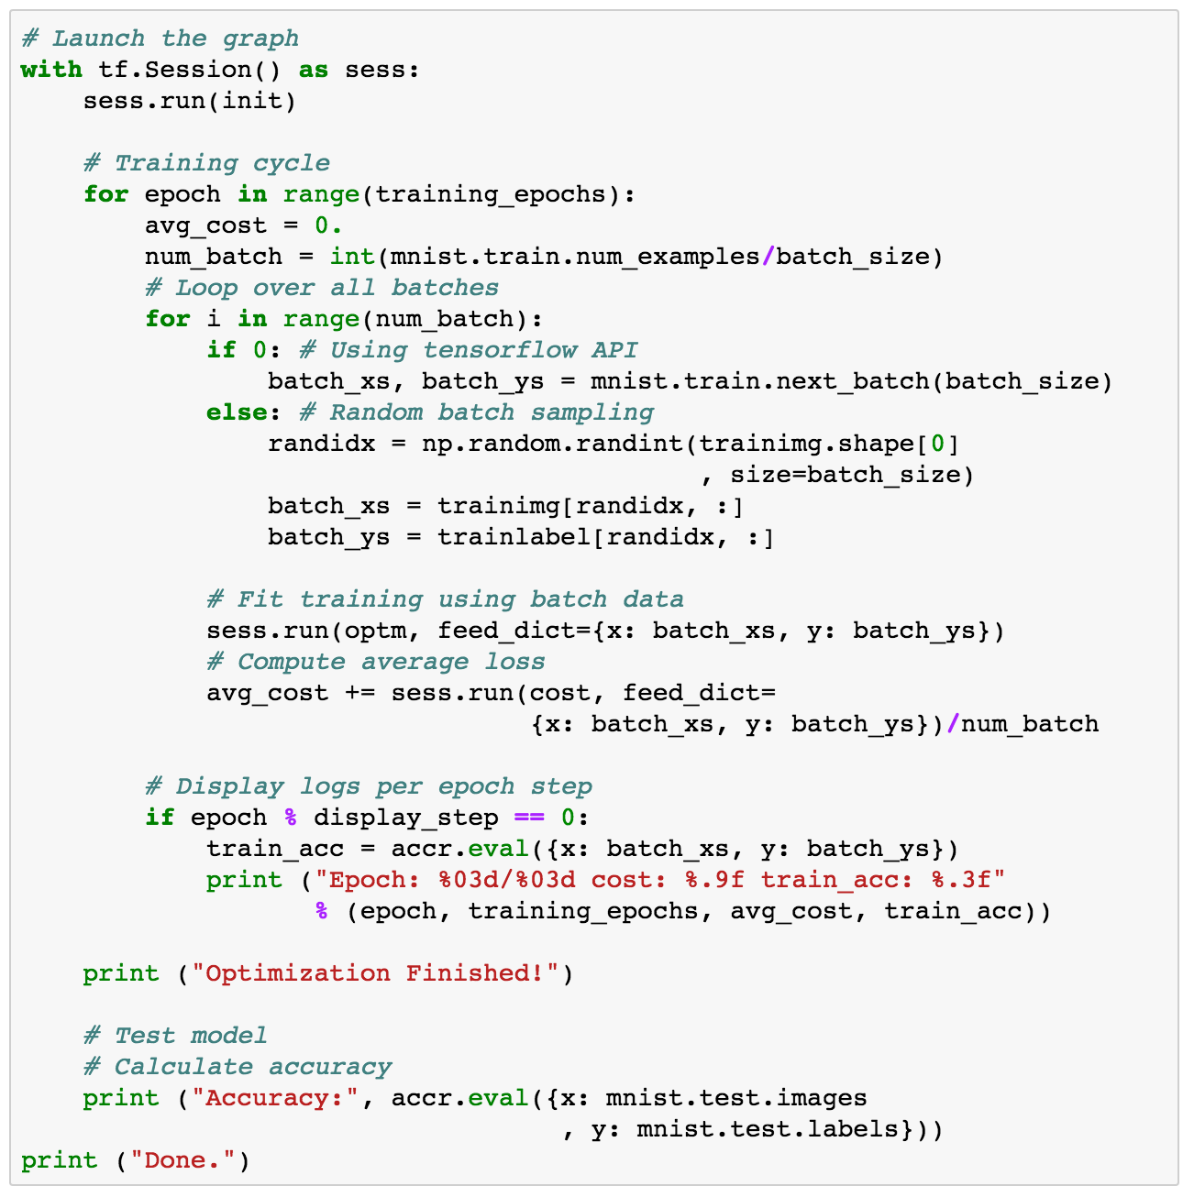
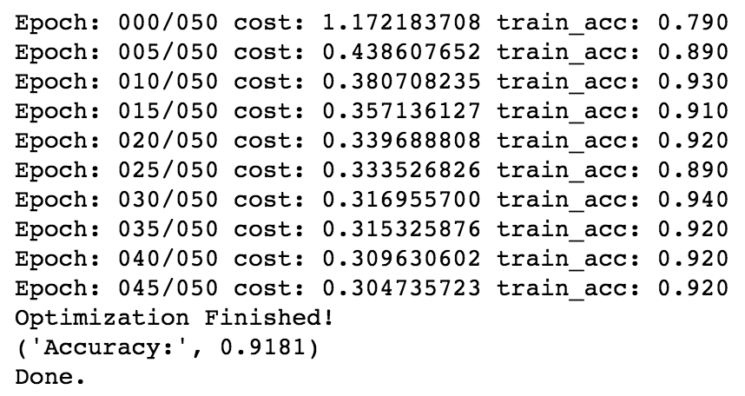
Run

